Slide 1
Image Analyser v1.0
Architecture Overview
By
Achuthaperumal RK
achuthaperumal@gmail.com
+91-9659774549

Slide 2
Introduction
Image Analyser is a simple tool that helps users in performing some of the basic image processing operations. Viz.,
Conversion of RGB to Grayscale
View Histograph
Image Thresholding
This tool is developed using LabVIEW based on the architecture called “Actor Framework” which is best known for it’s scalability.

Slide 3
Pre-Requisites
Software Components:
NI LabVIEW 2016 Full Development System
NI Vision Development Module 2016
NI Vision Acquisition Software August 2016 (IMAQdx Drivers)
Hardware Components:
A Camera/Frame grabber (IMAQdx Compatible)

Slide 4
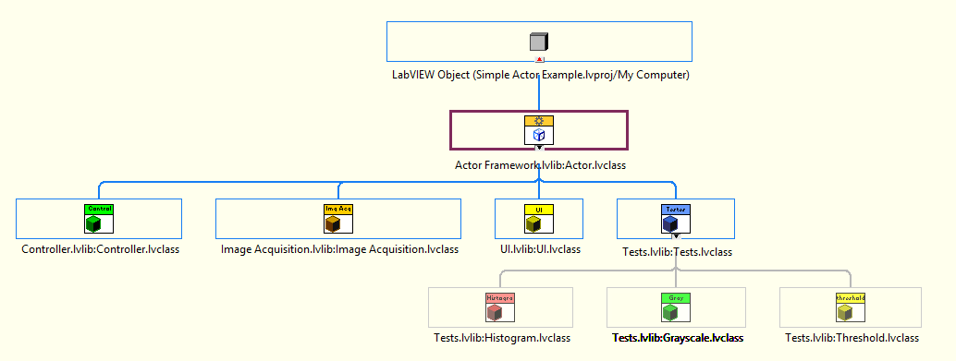
Actor Class Hierarchy
Defined in LabVIEW
User Developed

Slide 5
Actors’ Functionality
Controller – It’s the root actor. It schedules all other actor launches and handles error.
UI – User Interface actor. Called by Controller. It sends the user actions to the controller.
Image Acquisition – This actor will be used for acquiring images from the selected device. When user requests for acquisition , This actor will be called and Live Feed from the device will be shown on the UI actor.

Slide 6
Actors’ Functionality Contd.
Tests – This is a generic class for performing Image Processing Operations. Following actors are derived from this actor.
Grayscale – This actor gets an image and convert it to a grayscale image.
Threshold – This actor gets an image and convert it to a binary image based on the user specification.
Histogram – This actor gets an image and shows Histograph to the user.

Slide 7
Communication between Actors
Actors usually communicate through pre-created messages on both ends (sender and receiver).
As seen above, Each Test (Grayscale/Threshold/Histogram) requires an image to operate. So Image Acquisition actor has to have 3 different messages requesting the image and each test actor has to have one message for getting the image from the sender.
Considering the Scalability, when the number of test actors increase, the message count also gets increased. This leads to High-Coupling!
In order to avoid this, This application uses Zero Coupled class(Abstract Message Class) for image requisition and distribution.

Slide 8
Abstract Message Class
Kindly refer this link below to know How an Abstract Class Works:
https://forums.ni.com/t5/Actor-Framework-Documents/Beginner-Tutorial-Zero-Coupled-Actor-Project/ta-p/3533889
Usually Abstract class is directly derived from Message.lvclass and it will have the data to be sent in its private data (Image Msg.lvclass). It will send the data wherever it gets request from (Send Image.vi). Abstract class always created from Sender Node.

Slide 9
Contd.,
To receive the data, User needs create a child for this abstract class using which the data can be read using an accessor(Read Attributes.vi).
The Abstract class won’t have any “Do.vi” to execute a method. Instead the children of the abstract class will have its own “Do.vi” to send the data to their respective actors.
In the following slide, this application’s Message Class Hierarchy is shown.

Slide 10
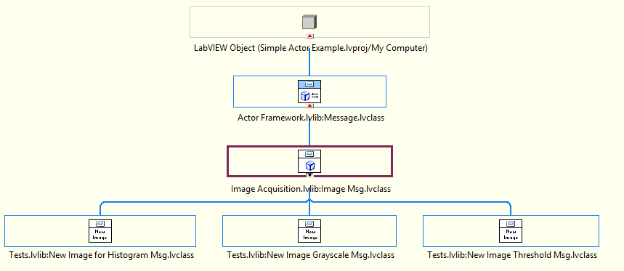
Message Class Hierarchy
Defined in LabVIEW
User Developed
Abstract Class(Parent)
Abstract Classes
(Children)

Slide 11
Contd.,
This is what happens when a Image request is raised:
When the Acquisition actor starts, It sends the Image Reference to the Abstract Class.
Each test actor should’ve derived a child of Abstract Class. So when image request is raised, test actor needs to send its child class and it’s self enqueuer, as a message to controller.
Controller will pass that message to that Image Acquisition actor.
Now once the message is received, acquisition actor will append the image reference to the child class and send to the test actor’s enqueuer.

Slide 12
Contd.,
5. Immediately it will be available in the child abstract class using which the request was sent. So now the image can be read from the same and shall be passed to the test actor.
Child Abstract Class & Grayscale
Actor Enqueuer
In a single message
Child Abstract Class & Grayscale
Actor Enqueuer
To Acquisition
Grayscale.lvclass
Controller.lvclass
Image Acquisition.lvclass
Update the image in Received Msg Class (New Image Grayscale.lvclass).
Send it to the Grayscale Enqueuer
Send Image Request.vi
Send Request For Imaget.vi
Do.vi - Read the image using accessor
Read Attibutes.vi
(Parent method)
Image Msg.lvclass (Abstract)
New Image Grayscale.lvclass
Child for Abstract
Send Image.vi
Image will be available in the child class

Slide 13
Other References
Refer the Help option in each window to know the details.
All other communication among actors are happening based on normal messaging.
Refer the block diagram of each VI for the detailed explanation.

